Slide 1
Using Data Analytics for
Customer Churn Prediction
Application for an Online Retailer
İlker Birbil, Sabancı University
(Birol Yüceoğlu and Işıl Öztürk, Migros)
University of Warwick
March, 2017

Slide 2

Motivation
Second largest FMCG retailer in Turkey (>1,400 stores)
Online store operating since 1997 in more than 20 cities
One of the pioneers of online FMCG retailing in Turkey
Strongly growing sector
Emerging competition
University-Industry partnership
(funded by TUBITAK-TEYDEB project)
Data Analytics for Customer Churn Prediction
March, 2017

Slide 3
Data Analytics for Customer Churn Prediction
Can we predict customers that may churn in the coming periods?
What is the length for the customer event history for prediction?
What are the important features affecting the customer churn?
How long does it take to loose the predictive power of the models?
March, 2017

Slide 4
Data Analytics for Customer Churn Prediction
Contractual
Noncontractual
Total defection
Switching is costly
Customer-churn definitions clear
Financial services Telecommunications
Insurance
Partial defection
Switching is easy
Customer-churn definitions not clear
Mail order
Retail
Online shopping
Logistic regression, random forests, SVM, boosting…
March, 2017

Slide 5
Data
Transaction-based (basket) data
Customer ID
Transaction amount and date
Product categories
Raw data is not very useful for prediction
Data Analytics for Customer Churn Prediction
March, 2017

Slide 6
Feature Extraction
Inter-purchase time
Time since last purchase
Length of relationship
Basket (amount, items)
Discounts
Private label
RFM
Aggregate Information
Data Analytics for Customer Churn Prediction
March, 2017

Slide 7
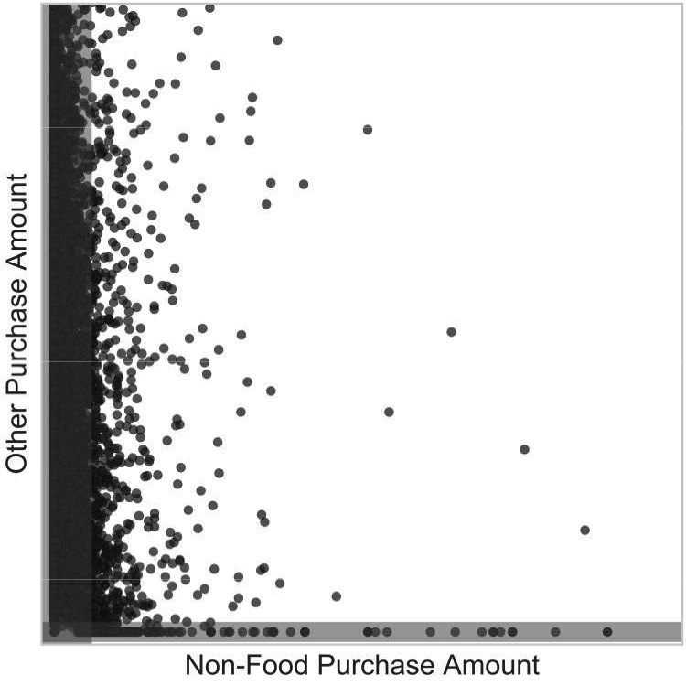
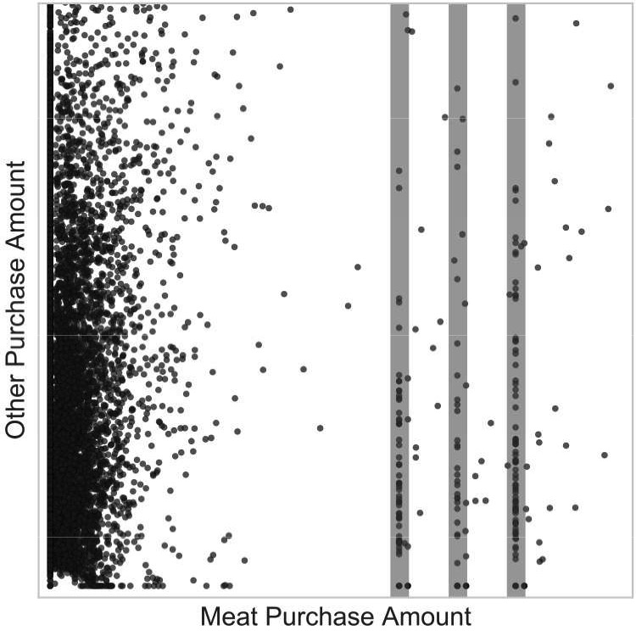
Data Cleaning
Seasonal items
Electronics
Textile
Tableware
Outliers
60% of the work!
Data Analytics for Customer Churn Prediction
March, 2017

Slide 8
Customers-Churners
Customer
At least two transactions in the last six months
Churner
Scenario A (partial defection):
Expenditure less than monthly average in the next three months
Scenario B (long term total defection):
No purchase in the next three months
Scenario C (short term total defection):
No purchase next month
Data Analytics for Customer Churn Prediction
March, 2017

Slide 9
Customers-Churners
Data Analytics for Customer Churn Prediction
March, 2017

Slide 10
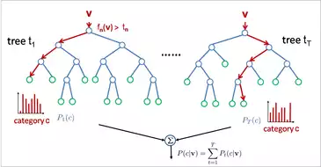
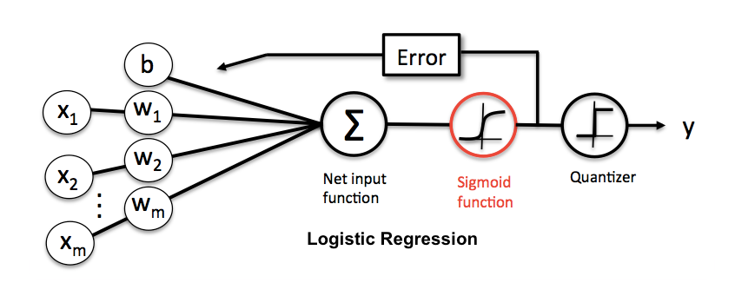
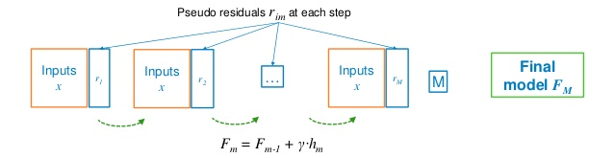
Classifiers
Random forests
Gradient boosting
Logistic regression
Data Analytics for Customer Churn Prediction
March, 2017

Slide 11
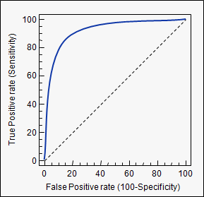
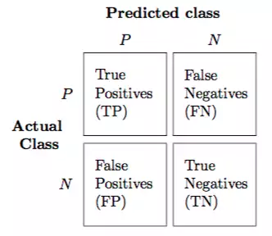
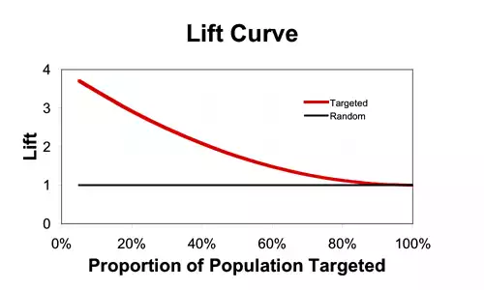
Evaluation
Area under the curve (AUC)
Top percentage lift
Percent correct classification (PCC)
Data Analytics for Customer Churn Prediction
March, 2017

Slide 12
Data Analytics for Customer Churn Prediction
Can we predict customers that may churn in the coming periods?
What is the length for the customer event history for prediction?
What are the important features affecting the customer churn?
How long does it take to loose the predictive power of the models?
March, 2017

Slide 13
Data Analytics for Customer Churn Prediction
Can we predict customers that may churn in the coming periods?
What is the length for the customer event history for prediction?
What are the important features affecting the customer churn?
How long does it take to loose the predictive power of the models?
March, 2017

Slide 14
Churn prediction
AUC and lift values similar to the ones reported in the literature
Gradient boosting outperforms the other two
Data Analytics for Customer Churn Prediction
March, 2017

Slide 15
Data Analytics for Customer Churn Prediction
Can we predict customers that may churn in the coming periods?
What is the length for the customer event history for prediction?
What are the important features affecting the customer churn?
How long does it take to loose the predictive power of the models?
March, 2017

Slide 16
Important Features
RFM variables
Length of relationship
Partial defection: categories 1 and 3
Long-term total defection: monetary
Short-term total defection: recency
Data Analytics for Customer Churn Prediction
March, 2017

Slide 17
Data Analytics for Customer Churn Prediction
Can we predict customers that may churn in the coming periods?
What is the length for the customer event history for prediction?
What are the important features affecting the customer churn?
How long does it take to loose the predictive power of the models?
March, 2017

Slide 18
Ballings and Van den Poel (2012)
“Although we are confident about our results, it is unclear whether they can be generalized over a wider range of subscription services. Hence, it would be interesting to validate our findings on customer databases in other industries.”
Data Analytics for Customer Churn Prediction
March, 2017

Slide 19
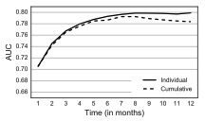
Event History
25 features
12 models (September, 2015 – November, 2016)
Smoothing effect of aggregation
Six- or seven-month history is sufficient
Validated Ballings and Van den Poel
Data Analytics for Customer Churn Prediction
March, 2017

Slide 20
Data Analytics for Customer Churn Prediction
Can we predict customers that may churn in the coming periods?
What is the length for the customer event history for prediction?
What are the important features affecting the customer churn?
How long does it take to loose the predictive power of the models?
March, 2017

Slide 21
Risseada et al. (2010)
“Although we are confident with the results, it remains unclear whether they are generalizable over a broader range of services that the two we studied..”
Data Analytics for Customer Churn Prediction
March, 2017

Slide 22
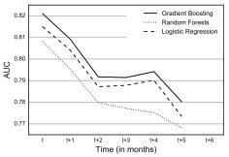
Predictive Power
Same model for the next six months
Sharp decrease after the third period
Slightly longer staying power than other sectors in the literature
Data Analytics for Customer Churn Prediction
March, 2017

Slide 23
Current System
Data Analytics for Customer Churn Prediction
March, 2017

Slide 24


In Practice
Customers who are 70% likely to skip shopping in the coming three months
All Customers
769 customers
Expected
538 customers
Actual
509 customers
Data Analytics for Customer Churn Prediction
March, 2017

Slide 25
Conclusion
New decision support system for churn prediction
Recency-frequency-monetary variables, some product categories are crucial
Length of the customer event history increases the prediction performance
Staying power in online retailing is slightly longer than other industries
Next: Incorporating promotional offers and targeted campaigns
Data Analytics for Customer Churn Prediction
March, 2017

